Slide 1




JORDAN - Arriving at a National Scale CPD Program
Presentation at the CIEs Conference march 2024

Slide 2
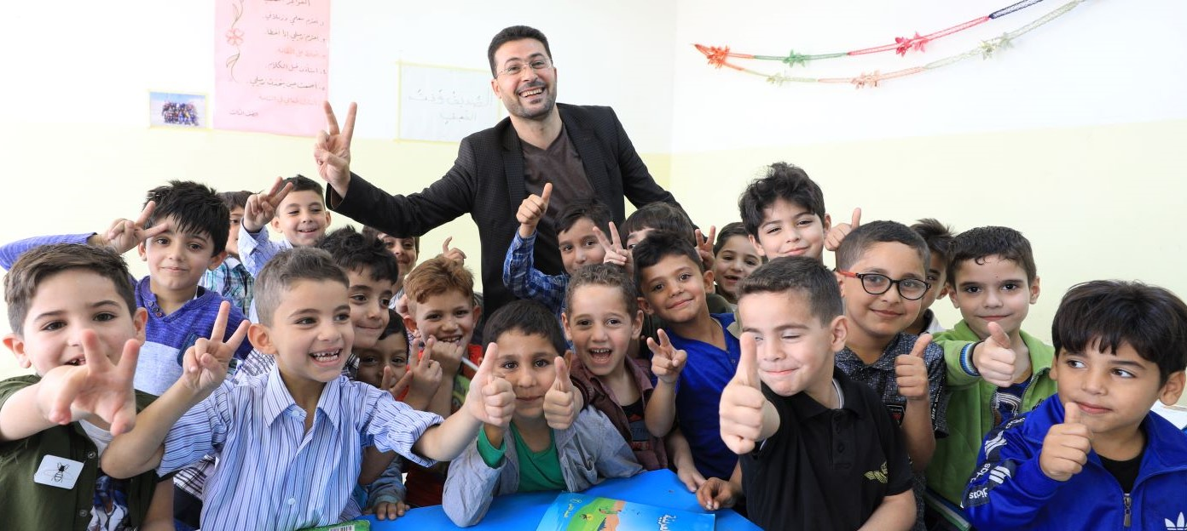
Background
With limited natural resources, a young population, and regional instability, Jordan’s political and economic stability depends on an educated population.
2012 assessment results revealed that the majority of grade two students in Jordan were unable to read at grade level fluency
2015 launched of Early Grade Reading and Mathematics Initiative
2023 Activity completed

Slide 3
In-Service Training: Context
70% of teachers have at least a bachelors degree
60% of teachers in G1-3 have an education specialization
90% of teachers participate in some form of professional development
National Teaching Standards
Career ladder requires certain number of units completed every 5 years
Initially, Foundational Skills Training provided through in-person 2-week courses
Source: 2018 National Teacher Survey
Notes:
Key message: a structure already exists and work force is competent

Slide 4

Four Initiatives
Face-to-face training (from 2017)
Transition to blended learning (from 2020)
School-based Communities of Practice (from 2021)
Coaching and Mentoring (from 2019)
Notes:
Key message: historical evolution toward wrap-around services

Slide 5

Face-to-Face Training
Map competencies of teacher training program against National Teaching Standards led to
RAMP Early Grades In-Service Teacher Training program accredited (Foundational Skills Program)
Early Grade Training Modules integrated into Supervisors/Principals/Teachers CPD and Career Path.
Notes:
Key message: Essentially established content for EG teaching strategies
The national accredited CPD program is implemented through:
Face-to-face training in nationwide trainings (workshops organized at district levels). This approach uses a cascade model where Master Trainers train Education Supervisors, who then train teachers. Although the limitations of the cascade model are well known, this approach is effective as it allows teachers to practice during the activities, it allows interaction between participants, and it puts all education practitioners on the same page (from central to school levels).
Essentially established content for EG teaching strategies

Slide 6
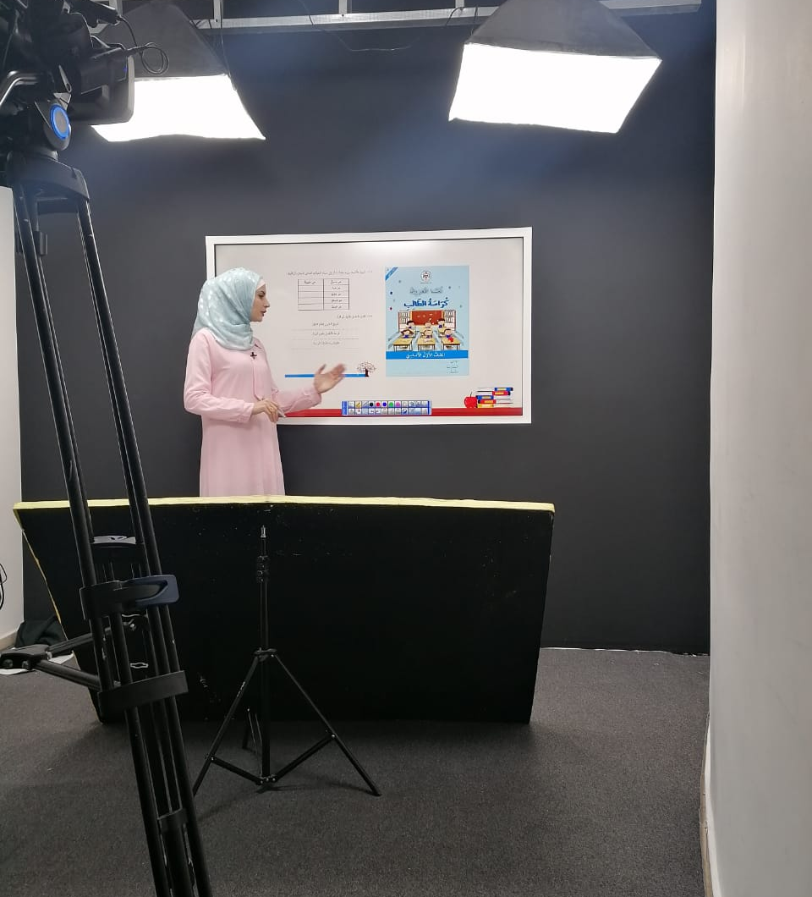
CPD and Coaching and Mentoring : Blended Training
Covid-19 lockdown led to development of E-training platform
Theoretical courses on-line combined with independent practice
Synchronous: virtual meeting rooms for question and answer sessions
Asynchronous: self-paced training using pre-recorded videos.
Notes:
Key message: covid forced system to adapt and it did not go back to where it was before.
Blended forms of training for the national CPD program: Theoretical courses are taken online, and teachers practice during in-person and face-to-face workshops. This form of training started to be implemented once RAMP developed the E-Training Platform during the COVID-19 lockdown. E-training can be:
Synchronous: Trainers or instructors and trainees are available and engaged at the same time, it includes “rooms” where discussions are held and trainees can exchange and answer questions.
Asynchronous and self-paced training: Courses are recorded and involve the study of documents and videos. The trainee can take and complete the course at their own pace.

Slide 7
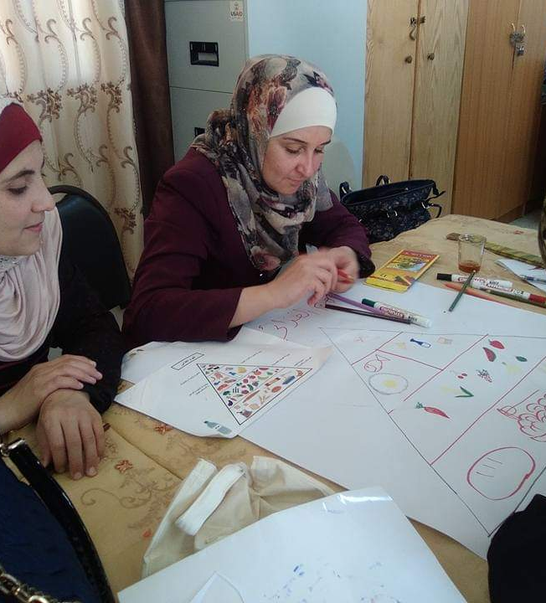
CPD and Coaching and Mentoring : Communities of Practice
Needs based training program delivered in Community of Practices (School based).
Monthly meetings facilitated by Education Supervisor or Senior teacher
Sharing experiences and reflective practice
Notes:
Key message: school-based – monthly and managed by dedicated professional.
Senior teacher added in response to time constraints for supervisor
Content based on school-demand

Slide 8
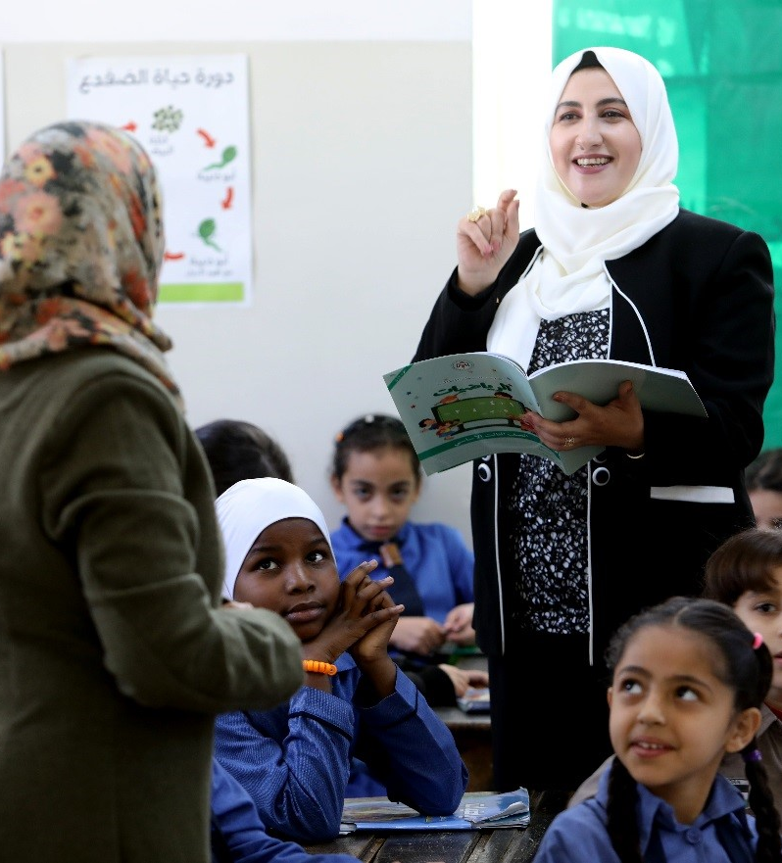
CPD and Coaching and Mentoring : Coaching/Mentoring
Supervisor’s Class observation and coaching tool unified for early grades
Differentiated Coaching program targeting schools and teachers in need of support. All 15,000 early grades teachers receive quarterly coaching visit.
Senior Teacher National surveys show better performance in schools with Senior Teachers.
Notes:
Key message:
Coaching initially delinked from training and COPs
Shift from 15,0000 to focused
is data driven based on learning outcomes
In-class support
Not possible to visit every teacher quarterly
Used learning data to target teachers with underperforming classes – focused coaching plans
Database maps progress of teacher and learners
Senior teacher took on coaching roles – 600 by end of program

Slide 9
The Teacher Continuous Professional Development journey
Foundation Skills Teacher Training
Needs Based Teacher Training (M1)
School Based Community of Practice
Needs Based Teacher Training (M2)
School Based Community of Practice
School Based Community of Practice
School Based Community of Practice
Coaching
Coaching
Coaching
Coaching
Notes:
Key message: content differs by rank in career path
Key message: content linked to competency framework and thus career path
As the CPD program was based on the Teacher Competency Framework and was articulated with the Teacher Career Path, it created incentives for teachers to complete the program and upgrade their qualifications, as teachers’ career progression is linked to professional development and skills upgrading
CPD modules have been developed for each rank of the career path. In higher teachers’ rank, such as the expert and lead teachers’ ranks, teachers must conduct an action-research to address an educational issue at their school or to publish a research paper.
For all ranks, teachers must create and develop a portfolio where they can show all their achievements.

Slide 10
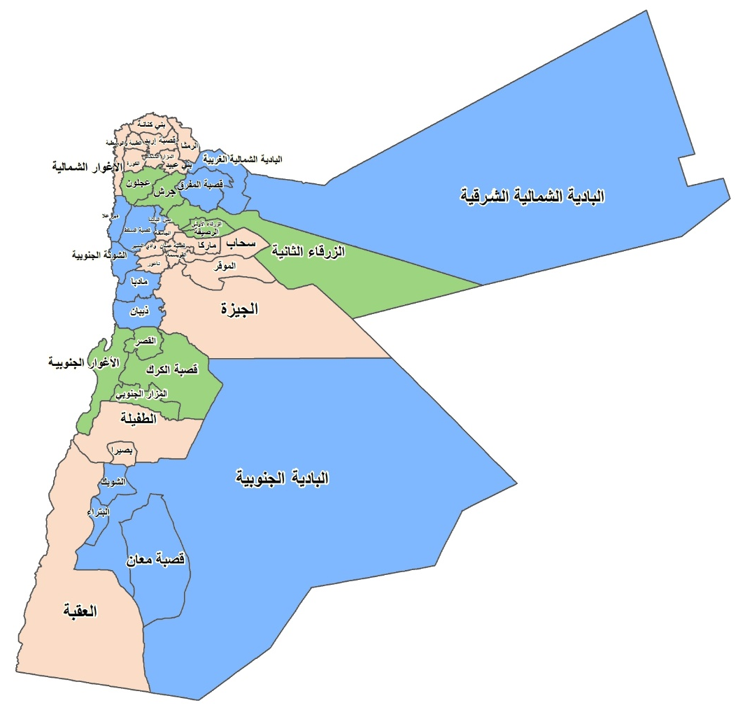
Sample-based learning assessment as a monitoring instrument
Field Directorate | Oral Reading Fluency | Oral Reading Zero Scores | Reading comprehend-sion | Silent Reading Comprehen-sion | Mathematics
Al qwesmeh | 13% | 7% | 24% | 34% | 26%
Al taibeh & Al wasteiah | 26% | 5% | 39% | 45% | 36%
Aljamaah | 20% | 5% | 38% | 54% | 31%
Amman Qasbah | 16% | 8% | 28% | 39% | 29%
Bani Obaid | 29% | 3% | 39% | 45% | 40%
Bsaira | 19% | 11% | 26% | 39% | 44%
Irbid Qasbah | 22% | 6% | 32% | 45% | 33%
Jezah | 6% | 14% | 20% | 36% | 25%
Notes:
Key message: targeted support – not all schools or all teachers were coached

Slide 11
Learning Outcomes aligned with Policy shifts
Notes:
Post-covid rebound coincided with focus on low performers and additional localized support to teachers
No causality, but probably more than a happy coincidence

Slide 12

Thank you!
Contact Information
Alastair Rodd arodd@rti.org

Slide 13

Why does early grade literacy and numeracy matter?
Predictive of how students will perform in upper primary and secondary school
Foundational skills for adult readiness for economic participation and
Can increase national growth rates by up to 2%
→ Early Grades need to be prioritized in MOE planning / budget allocations.

Slide 14
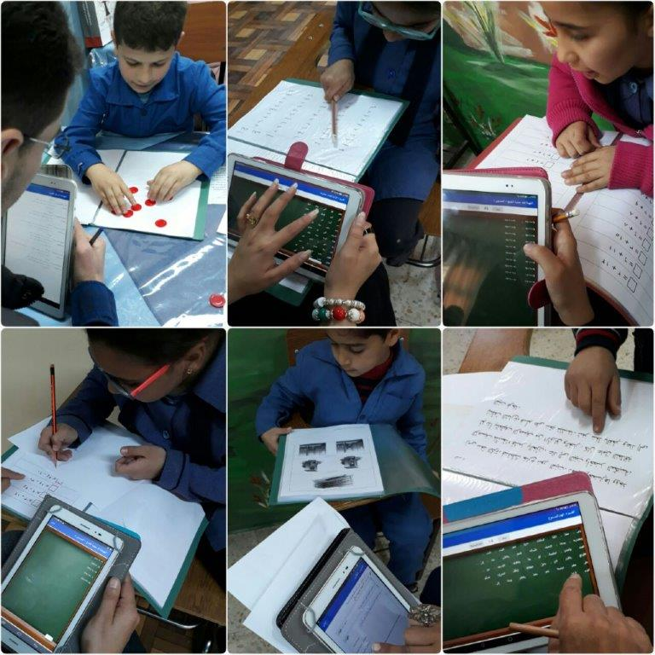
2019 EGRA/EGMA

Slide 15
EGRA by Gender / Silent Reading Scores

Slide 16
Early Grades Mathematics Assessment

Slide 17
Theory of Change
If RAMP integrates best practices in all Teaching / Learning Material
If the initiative focuses efforts on the weakest schools and children;
If RAMP improves continuously the capacity of Education Administrators and Teachers to monitor and improve students’ performance;
If accountability measures are developed and implemented
If dialogue is improved between schools and parents on student’s performance;
If reflective practices at all levels are used and institutionalized
Then the early grade initiative will be implemented more systematically
And eventually, a substantially higher proportion of grade 2 and grade 3 public school children will be able to perform at grade-level

Slide 18
Strategic Alignment
Education Strategic Plan 2018-2022
National Strategy for Human Resource Development
USAID Education Strategy
UN Sustainable Development Goals

Slide 19
Data for Evidence-based Decision Making
Level | Assessment / Evaluation | Outputs | Usage | Stakeholders
Central | Bi-annual National Survey EGRA / EGMA (sample) Annual National Gr.3 Examination | National Survey Report. | Informs national strategies and CPD | Examination & Testing
Field Directorates | LQAS survey (sample of students in each school). | Production of FD performance reports. | Informs FD Improvement Plan | ETC Examination & Testing Accountability Unit
School | LQAS survey (sample of students in each school). | Production of School Report Cards | Informs School Improvement Plans Discussed with Parents during GA of PTCs. | ETC Examination & Testing Accountability Unit
Classroom | Diagnostic Assessment (Coarse/Fine Grain) | Assessment of foundation skills | Informs remedial instruction. | Teachers
Classroom | Assessment Program | Students Performance | Formative Evaluation; informs teachers practice and teaching / learning plans. Differentiated instruction / remedial program. | FDs; School Principals; Teachers

Slide 20
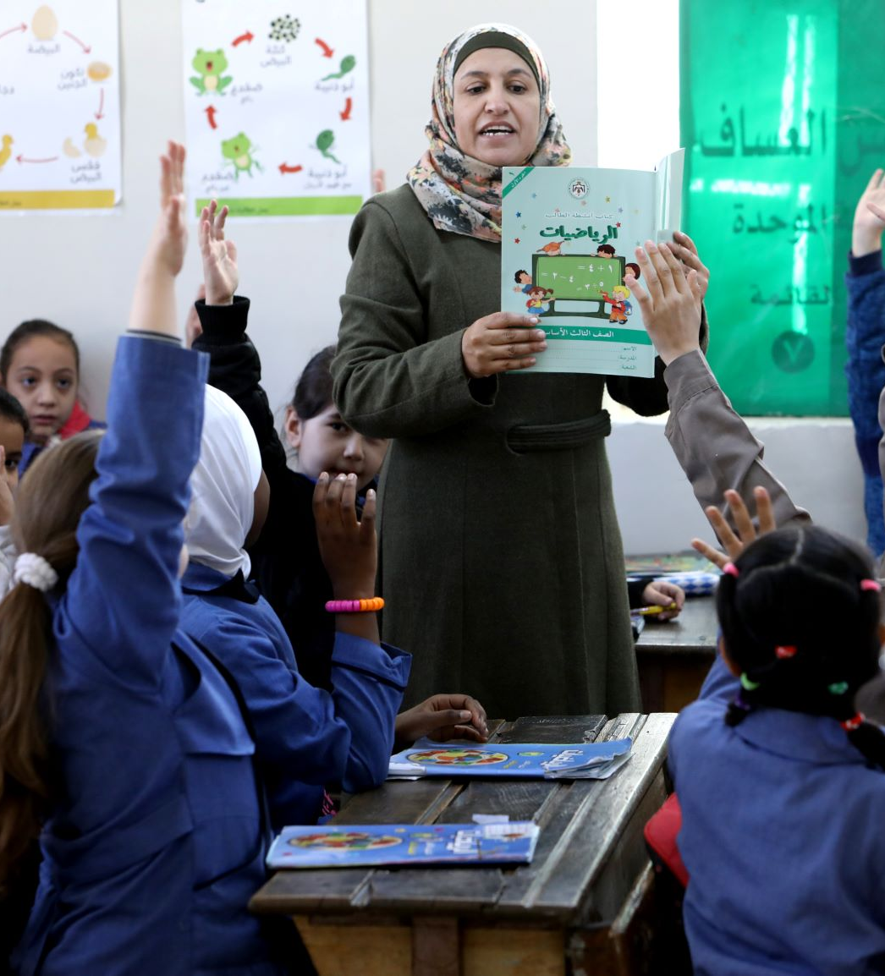
Curriculum and Teaching and Learning Materials
RAMP participates in NCCD committees reviewing Early Grades national curriculum framework and integrated early grades best practices (with systemic approach to phonics instruction and reading comprehension skills development).
MOE Teacher Guides reviewed and integrate RAMP strategies and teaching approaches; teachers are guided through instruction steps in a coherent and systematic way.
G1-G3 Students Workbooks developed and aligned with curriculum and textbooks progressions.
Reading Kits (story books and reading log sheets) distributed to all classes every semester (RAMP endline showed that the number of children reading at school and bringing books back home from school is increasing; as expected, data also reflect a positive association between reading outside the classroom and student performance.).

Slide 21
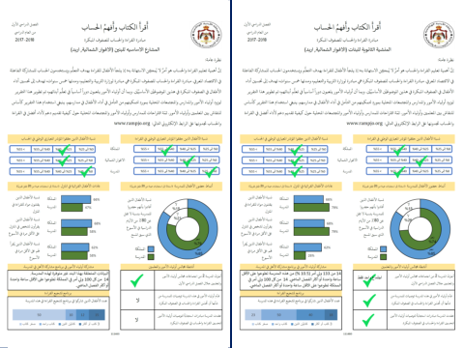
Community Engagement
School Report Card (Early Grades)
Community Mobilization Working Groups institutionalized at national and FD levels.
Parental Involvement Program implemented and monitored by CM Working Groups
Presentation of early grades school performance during General Assembly of PTCs → accountability school-parents increases .
→ School Principals play a key role in building School-Parents accountability and in monitoring quality of instruction and performance.

Slide 22
Management and Governance Structure Technical Assistance and Direct Finance
Ministry of Education | RAMP Technical Assistance | USAID Partnership for Education (direct-finance agreement)
Steering and Technical Committees Continuous Professional Development institutionalized along Teachers Career Path. Teachers regular coaching Annual Assessment Curriculum integrates best practices. Development of teaching standards. Printing of RAMP mathematics student workbooks MOE Assessors 170 MOE Supervisors (coaching, COP, teacher evaluations) | Curriculum and TLM design CPD of school administrators and teachers System strengthening: monitoring evaluation / increased accountability | School Readiness Program Student reading workbooks Story books for Classroom Libraries EGRA / EGMA LQAS Pilot Studies on Decodable readers ECA in early grade literacy

Slide 23
Research Studies
Kg Access Mapping (2018)
Education of Children with Disability (2018)
Time on Task (2020)
Effect of provision of Decodable Leveled Readers (2021)
As per MOE 2020-21 Research Agenda (to be defined)

Slide 24
Next Steps
Children need more reading time in school and outside of school. MOE should increase time allocated to reading instruction.
Weak and vulnerable children need to be included in the learning process; this is even more true at time of distance learning to which they probably do not have access. Inclusiveness should be emphasized at all levels.
Children with disability
MOE needs support to expand best practices to upper grades (e.g. coaching system and supervision management system; Expert/Senior Teacher model)

